Slide 1
FYP5: Object Detection, Tracking and Suspicious Activity Recognition for Maritime Surveillance using Thermal Vision

Slide 2
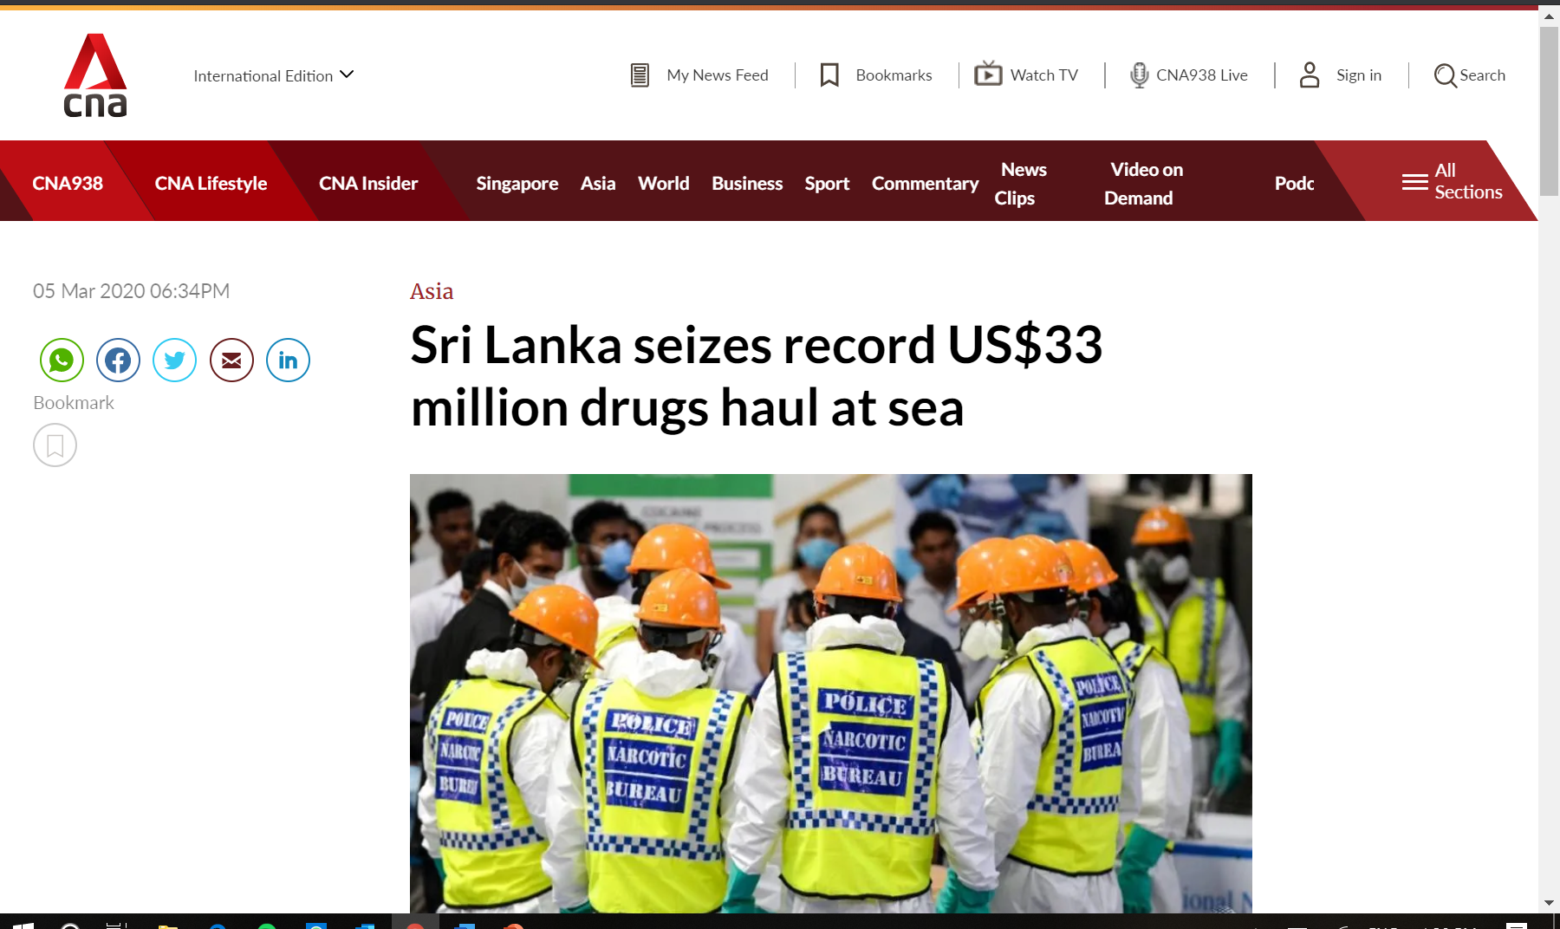

Keeping a watchful eye at Sea

Slide 3
Initial Work
Literature Survey
Pedestrian Detection in Thermal Images Using Adaptive Fuzzy C-Means Clustering and Convolutional Neural Networks (ICMVA - 2015)
Object Classification in Thermal Images using Convolutional Neural Networks for Search and Rescue Missions with Unmanned Aerial Systems (IJCNN – 2018)
Convolutional Neural Network Based on Extreme Learning Machine for Maritime Ships Recognition in Infrared Images (MDPI Sensors – 2018)
VAIS: A Dataset for Recognizing Maritime Imagery in the Visible and Infrared Spectrums (CVPR – 2015)

Slide 4
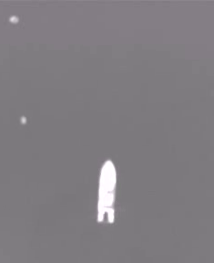
Initial Work
Review of existing Thermal Dataset
Singapore maritime dataset - https://sites.google.com/site/dilipprasad/home/singapore-maritime-dataset
Italian maritime dataset - http://www.dis.uniroma1.it/~labrococo/MAR/
Seagull dataset – http://vislab.isr.tecnico.ulisboa.pt/seagull-dataset/

Slide 5
